Slide 1



Otherworldy Descriptions

Slide 2
Scenario
You have been misbehaving. Unfortunately, your most hated teacher has kicked you out of the classroom for talking. You sit outside, but the world looks a little different. The everyday things you see - stairs, grass, the sky – do not look the same…
Find a quiet space outside and describe the world as if you have never seen it before…

Slide 3
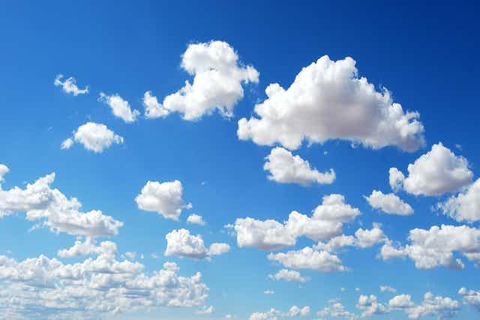
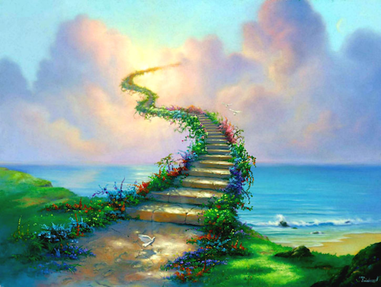
Sky or… stairway to heaven

Slide 4
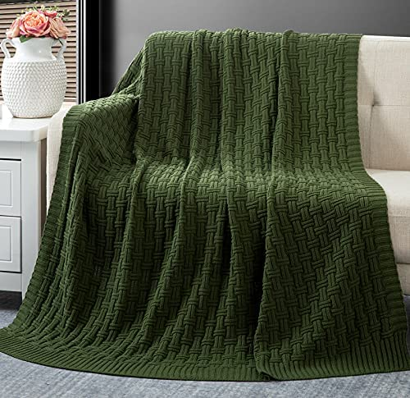
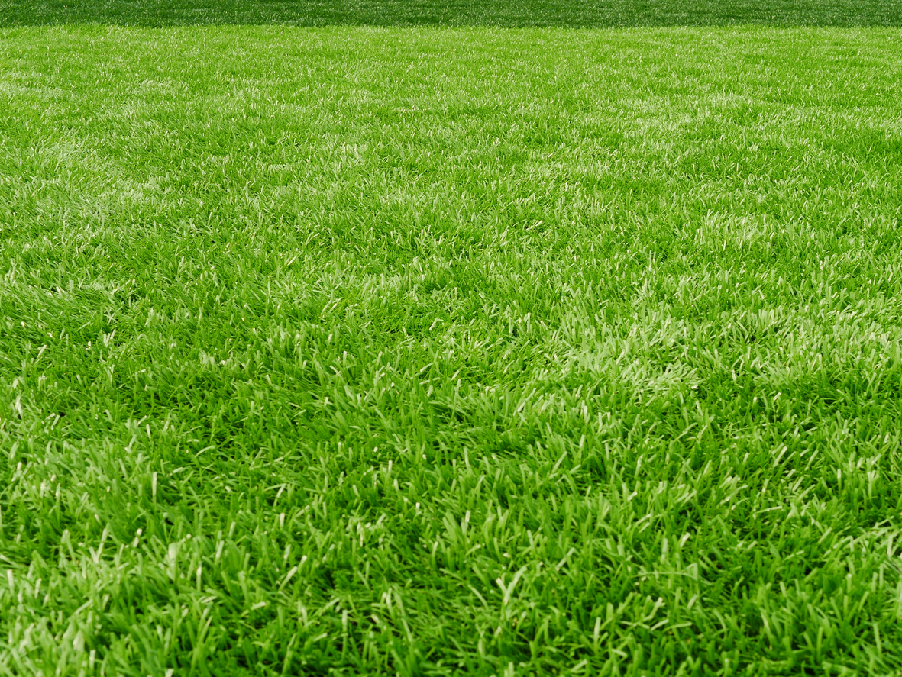
Grass or…Emerald blanket

Slide 5

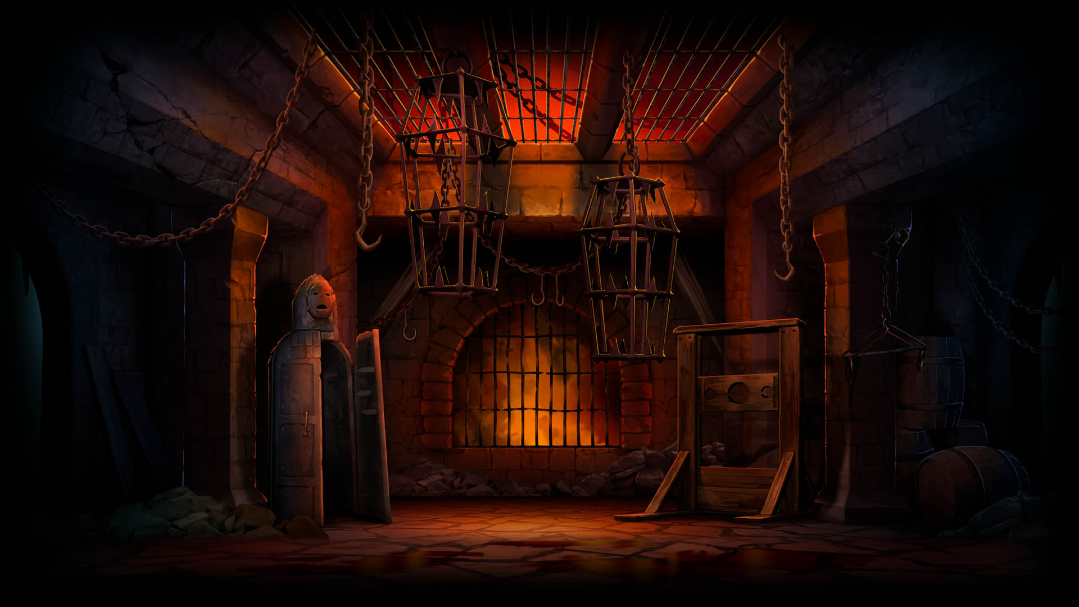
School or…institute of death

